Slide 1
Determining the best place for my Own Venture!

Slide 2
¿Why are we interested in determine a place to start a business?
When we talk about investing money, we will always pretend a low risk of failure
There are almost infinite places to start a venture, we seek to reduce this universe of possibilities
today there is a lot of public access data to analyze the above
With the right tools we can perform analysis tasks and in this way we can recommend the neighborhoods where to open our business

Slide 3
Data acquisition
Information about neighborhoods in Toronto from Wikipedia article
The coordinates from each neighborhood from Nominatim api with python (geopy library)
Venues within each neighborhood from foursquare api

Slide 4
Data preparation
The “not assigned” neighborhoods were dropped
With the calculated coordinates, we eliminated the neighborhoods where the NOMINATIM API returned us empty
a deduplication of those neighborhoods where the coordinates coincided was made
With all the geolocated neighborhoods on a map, it was determined that there were no large empty gaps left without analyzing
analysis radios were calculated in each neighborhood to use the Foursquare API

Slide 5
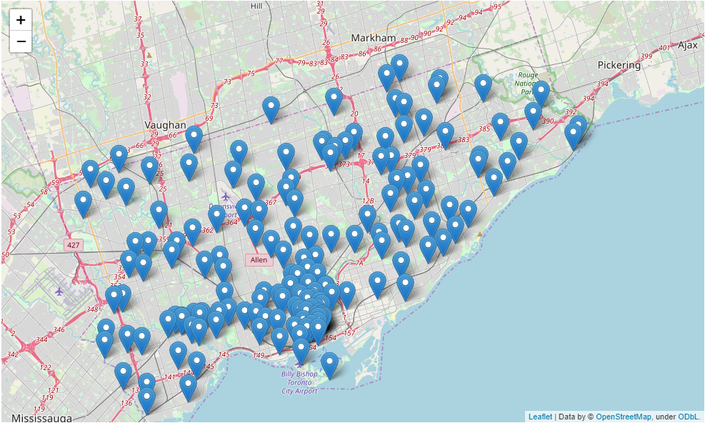
Neighborhoods geolocated

Slide 6
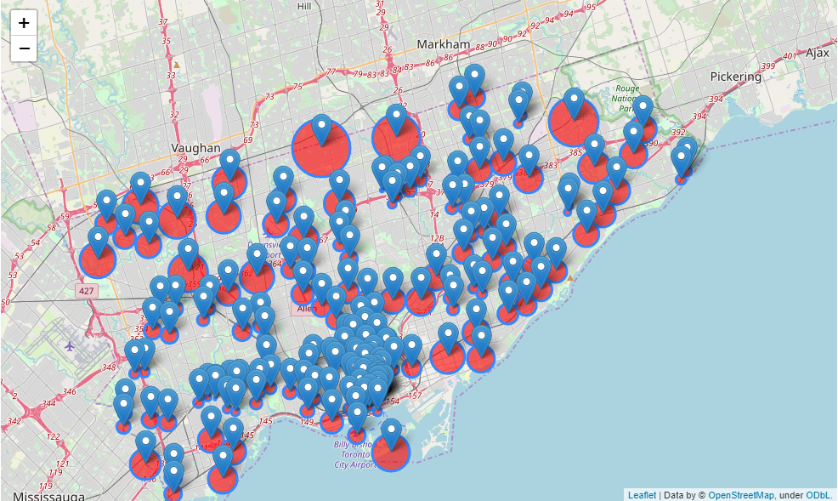
Neighborhoods with their defined analysis radios

Slide 7
Definition of new variable to model
We previously defined 2 categories of interest: "Coffee Shop" and "Café“
for each neighborhood, the amount of venues belonging to these categories was calculated
using the radius analyzed in the Foursquare API, the density of venues was determined
Venue density = quantity of venues / radius

Slide 8
KNN algorithm
to apply the algorithm, 5 clusters will be used
the input variables to the model will be the average of venues per category + density of venues
The objective is to find the cluster where coffee businesses exist in quantity, that is, they have regular customers
With the cluster of interest found, the idea is to make a recommendation of at least 5 neighborhoods
for this recommendation, a visual analysis of the findings will be carried out

Slide 9
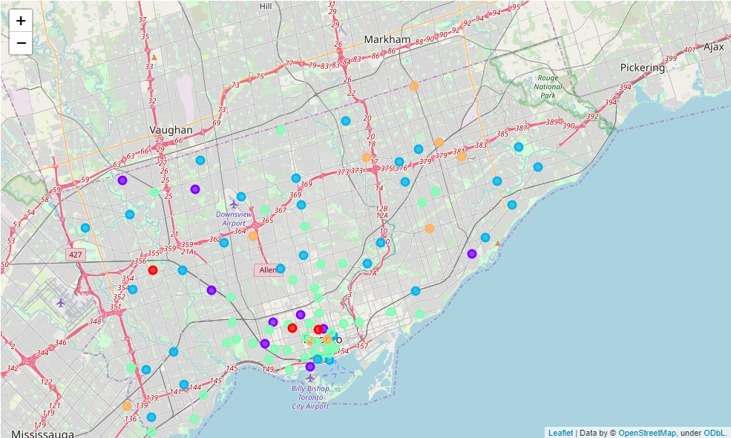
Clustered neighborhoods

Slide 10
Finding our cluster of interest
We prepare a list of the 20 neighborhoods with the highest density of venues belonging to our competition
from each of those neighborhoods, we obtained the cluster calculated by the KNN algorithm
we see that 14 of the 20 neighborhoods coincide in the same cluster: number 3
we determine that our candidates are included in said cluster

Slide 11
Cluster 3 analysis
the cluster has a total of 44 neighborhoods
most are close to the university of Toronto
we can divide 2 areas of interest: one where the neighborhoods are closest to the densest and another where the neighborhoods are far away
Both zones detected are valid but pursue different objectives related to the risk of greater or lesser near, non-direct competition (the latter we try to avoid it)

Slide 12
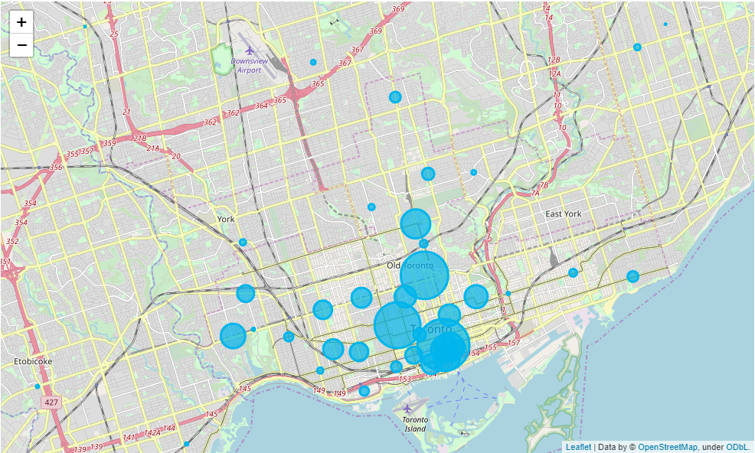
Cluster 3 on a map

Slide 13
Recommended areas
Area 1:
- Forest Hill North
- Parkdale
- Leaside
- Riverdale
Area 2:
- High Park
- Silverthorn
- Wexford
- Wilson Heighs

Slide 14
Conclusion
Depending on the risks or objectives that are pursued with the coffee business, at least 2 areas with 4 neighborhoods each were listed to start the venture
Our project does not guarantee 100% success, but tries to approach that number as much as possible by performing data analysis
The final decision of where to start the venture will also be tied to variables or factors not analyzed, such as the number of tourists per neighborhood, attractive building, or others
We hope it is a contribution to help make the difficult decision to enter the world of entrepreneurs and to be able to say the famous phrase "I am my own boss"

